Slide 1


Hi! We are Master, and Cohesion
Master International Logistics (Hong Kong, Italy).
Newly opened in Italy, Milano. Focusing on strengthening the operations and potential of our Chinese partners and shareholders in Europe.
Cohesion Freight Worldwide (China, Hong Kong, Taiwan, United States of America, Cambodia, Vietnam).
30 years of history for 1,500 people, in 23 branches. 200,000 TEUs moved in 2020. Daily operated charter flights.
Among the top 15 NVOCC on the Trans-Pacific trade lane.
Presentation by Marco Cavicchioli :
Executive Director of Strategy, Technology, and Information in Cohesion Freight Worldwide,
Executive Director in Master International Logistics
With the patronage of Mr Huang Shun, Shareholder and Managing Director of Cohesion Freight Worldwide and Master International Logistics.

Slide 2
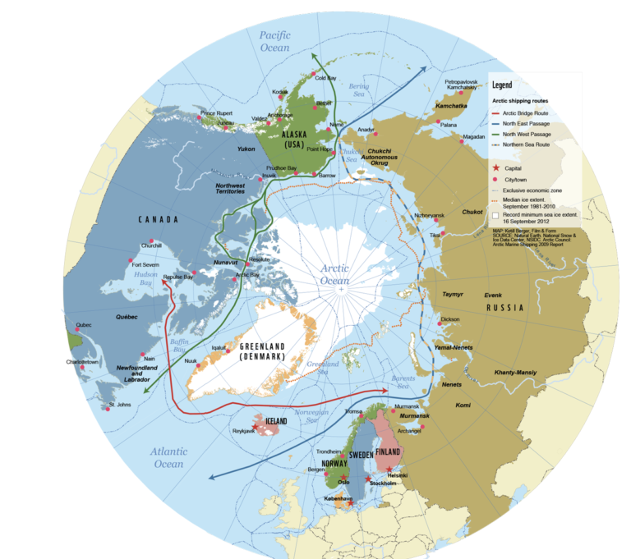
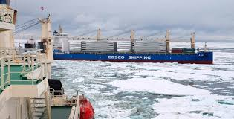
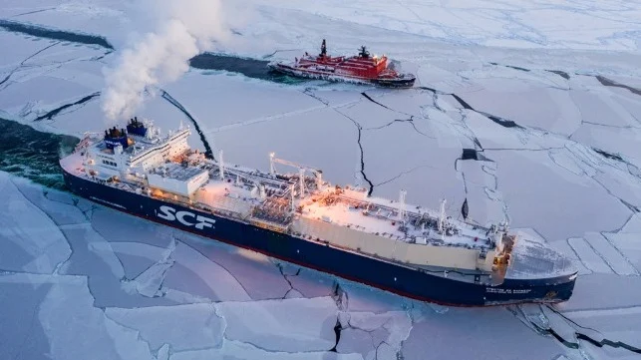
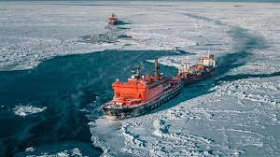
Northern Sea Route (NSR) – What is it? An uncommon term among Freight Forwarders.
Northwest Passage (NWP) : United States of America (East Coast) > Canada > United States of America (West Coast) > Europe (Iceland, United Kingdom, Norway, Northwest Continental Europe)
Northeast Passage (NEP) : Russia (Eastern) > Europe (Norway, United Kingdom, Northern Continental Europe)

Slide 3
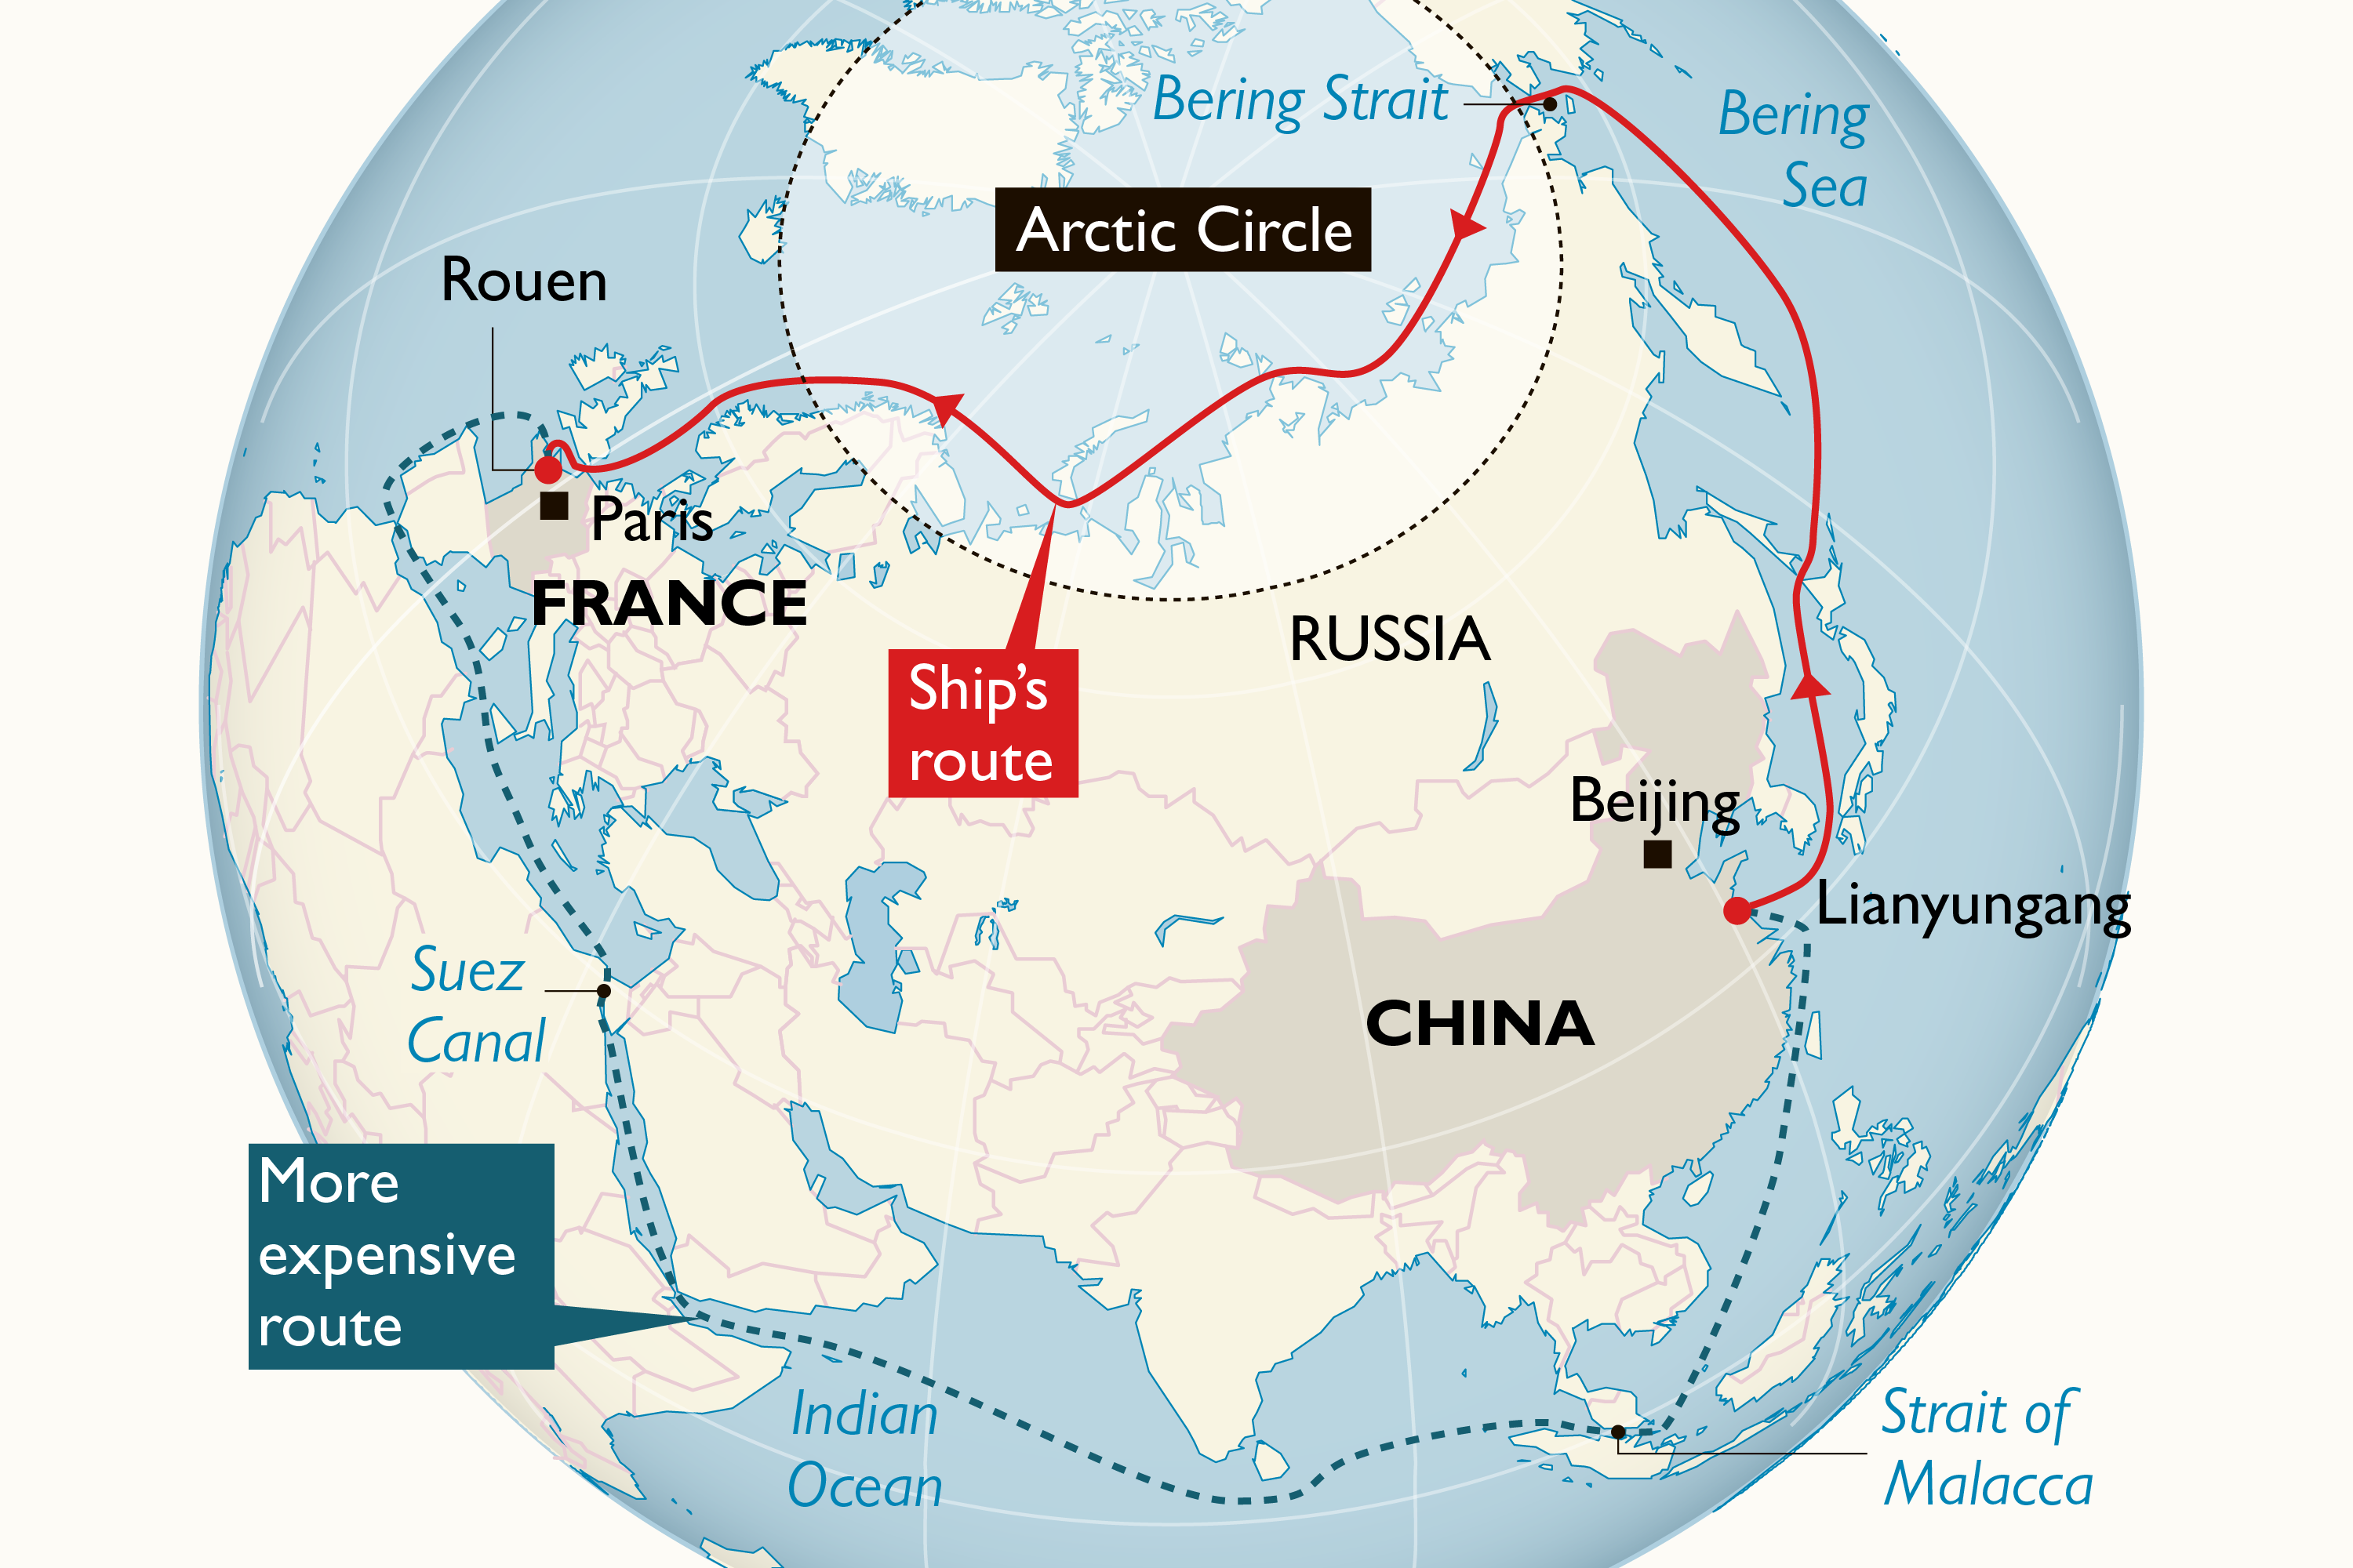
Northern Sea Route (NSR) – How could it affect Global Supply Chain (GSC)?
NSR vs SSR [PROS in favour of NSR]
4,000 miles shorter compared to the Southern Sea Route (SSR), or -25% average.
    > Reduced Costs
    > Reduced Transit Time
2) Rapidly increasing feasibility over the years due to ice melting.
NSR vs SSR [CONS against NSR]
Turbulence caused by shift in geopolitical control.
Geographical instability.
Infrastructural investments.
Environmental concerns.
Source: Melting Ice Caps and the Economic Impact of Opening the Northern Sea Route
CPB Netherlands Bureau for Economic Policy Analysis

Slide 4
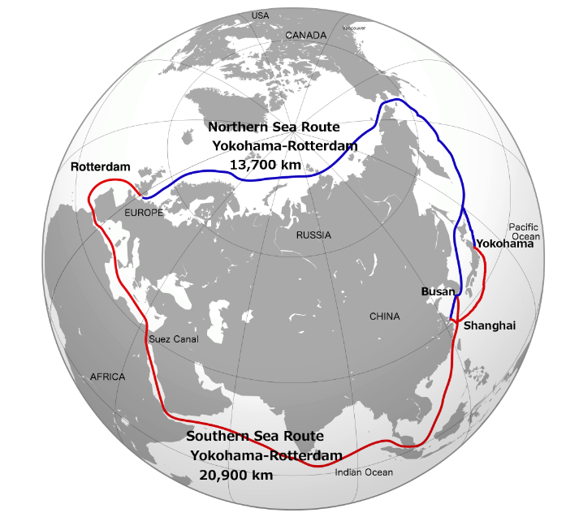
Northern Sea Route (NSR) – Who is affected?
A stronger NSR would lead to :
Less Intra-EU transportation.
Increased trade relationships and political power of Northern EU countries.
Decreased trade relationships and political power of Southern Asian and Southern European countries.
Diversification of Trade Status.
New Supply Chain capabilities
Source : Melting Ice Caps and the Economic Impact of Opening the Northern Sea Route
CPB Netherlands Bureau for Economic Policy Analysis

Slide 5
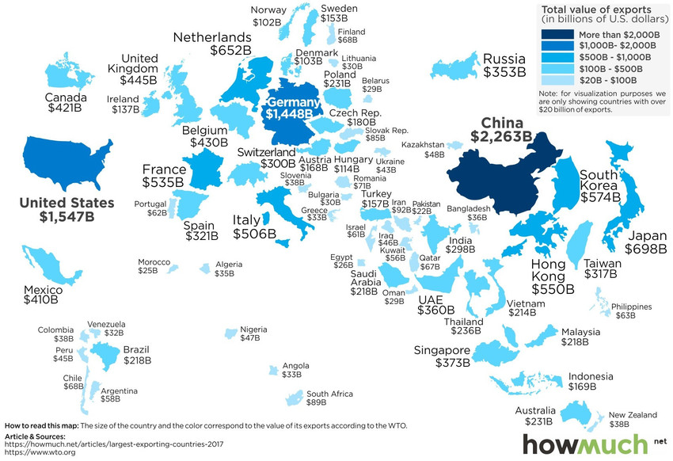
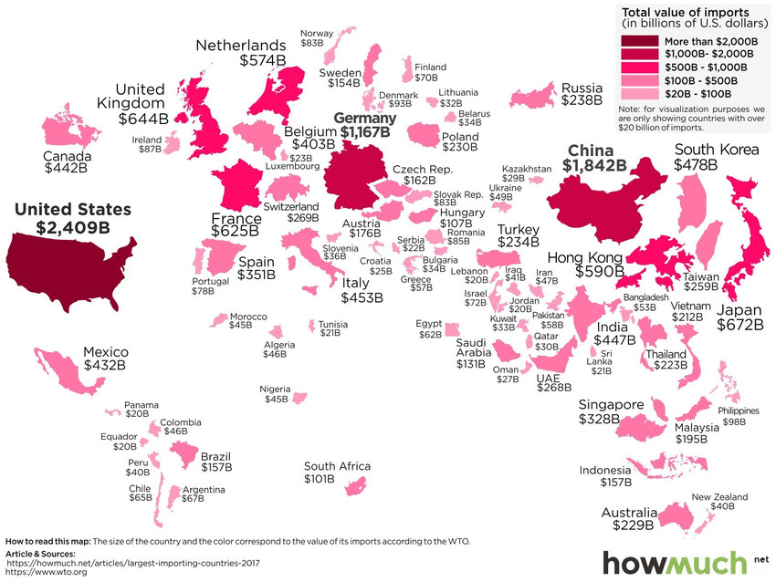
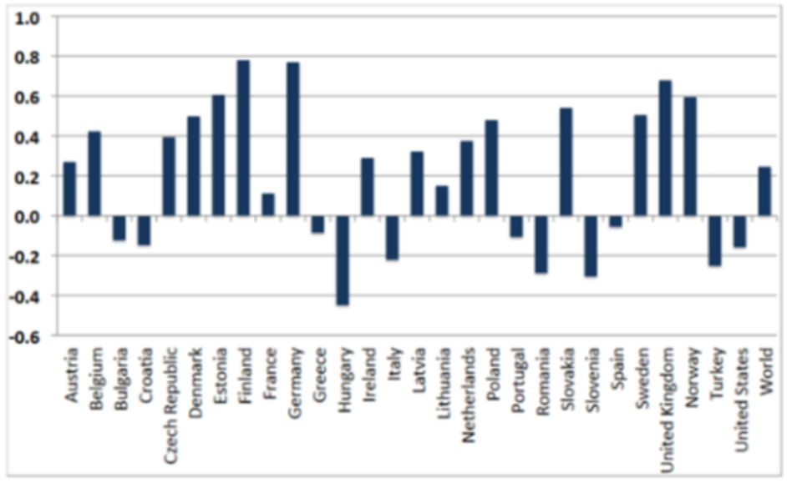
Major Exporters (WEF, WTO, 2018)
Northern Sea Route (NSR) – Who is affected?
Positively affected : Northern Asian Countries, Northern European Countries
Negatively affected : Southern Asian Countries, Southern European Countries, Middle East transit Countries
Projection of affected countries trade increase / decrease (CPB Netherlands, 2019)
Major Importers (WEF, WTO, 2018)

Slide 6
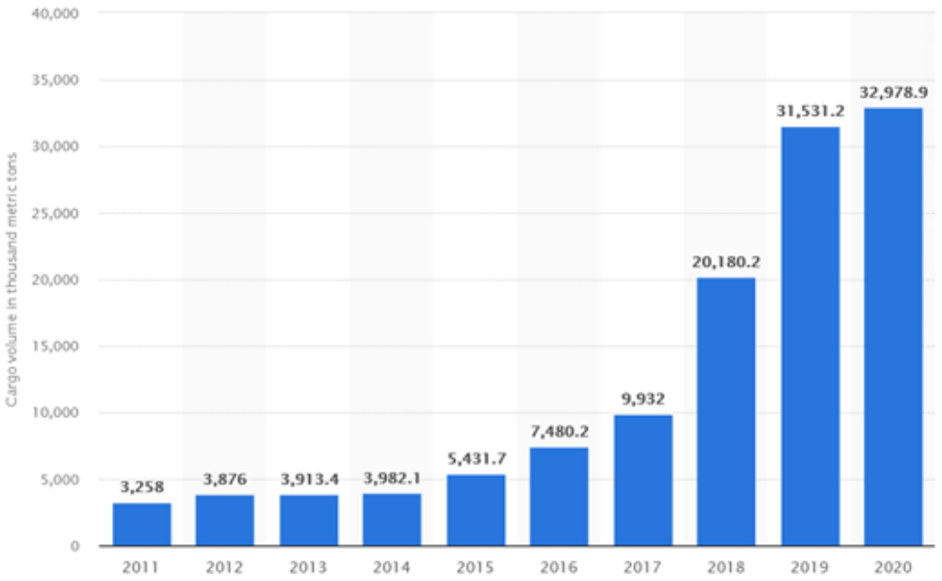
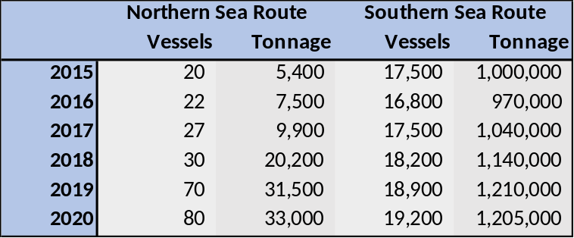
Northern Sea Route (NSR) – Is it actual?
19,000 vessels /year through Suez Canal VS 100 vessels /year through NSR
1,205,000 M tons /year through Suez Canal VS 33,000 M tons /year through NSR
What does Global Supply Chain (GSC) rely upon?
Shipping operations (Just in Time):
Predictability
Punctuality
Economies of scale
Is NSR a potential main route?
Is NSR a potential parallel route?
Tonnage transit by the NSR from 2011 to 2020 (WTO, 2021)
NSR vs SSR, 2015 to 2020 (Suez Canal Corporate Body, Northern Sea Route Information Office)

Slide 7
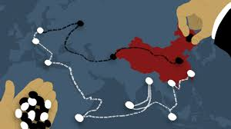


Macro Political and Economic Factors and Challenges
Chinese export diversification
  Decrease of mass production
  Increase of high added value products
  Shift of mass production to ASEAN countries
  Increase in economic and political influence
Pandemic
  High stress on Global Supply Chain
  Rapid decline of Just-in-Time models
Ukrainian conflict
  Halt in trade relationships between EU and Russia
  Halt in LNG investments
  Halt in infrastructures investments
  Militarization of Arctic areas (e.g. Cold Response 2022)

Slide 8
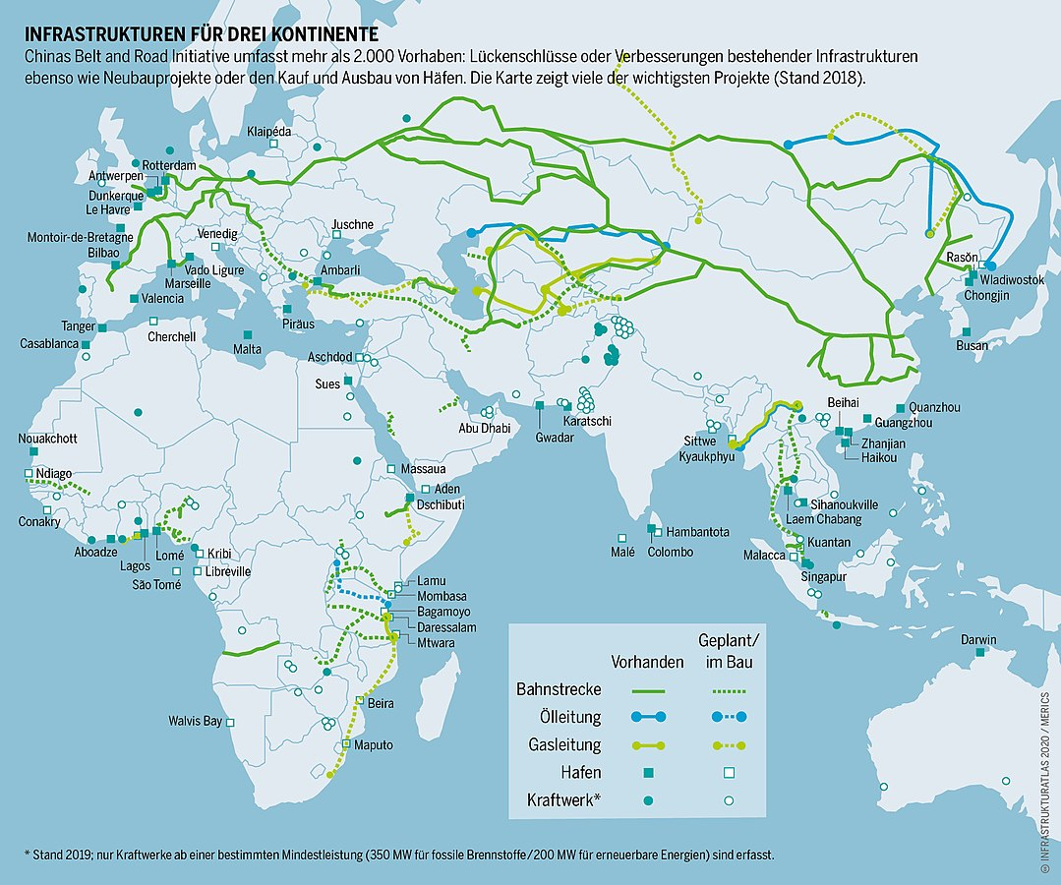
One Belt, One Road
一带一路
Silk Road Economic Belt (One Belt)
XXI Century Maritime Silk Road (One Road)
Presented in 2013, incorporated in the Constitution of China in 2017.
70 countries participating, >1T USD invested.
Target completion date 2049.
Investment in infrastructures, transportation services, logistics.
  China is the largest bilateral lender worldwide [Washington Post, 2021]. Collaterals to developing countries include cash equivalent reserves, rights to land or mine, infrastructures ownerships.
Facilitation of international trade.
Increased influence over participating countries.
Shift in geopolitical, and macro economical equilibrium.

Slide 9
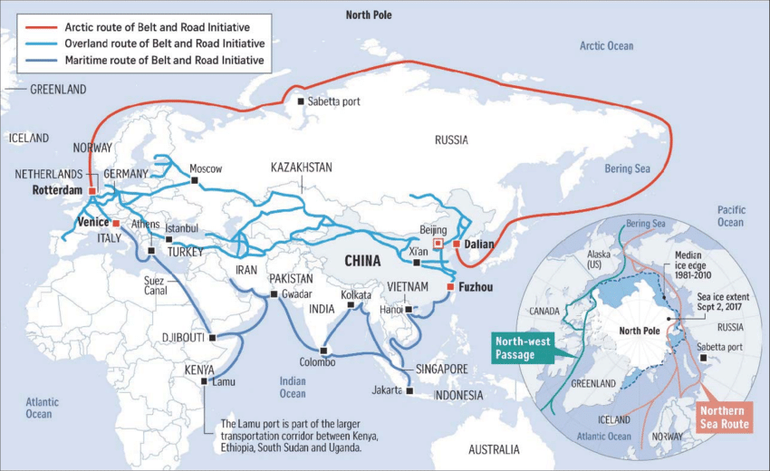
One Belt, One Road
一带一路
Polar Silk Road
First formally mentioned in 2013. Actively engaged in 2018.
Formalized as a target by China in its Five-Years Plan (2021-2025) in 2021 [Reuters, 2021]
Implications
ASEAN countries, already affected by the One Belt initiative, will see their influence decrease further.
A new fully Sea Freight operated shorter route will benefit Northern Asian countries and particularly the Northern and Western Chinese regions.
Russia will play a potential leading role in supply chain.

Slide 10
Northern Sea Route – An International Freight Forwarder Perspective.
1) Shift in Status Quo VS New opportunities
  Where to invest?
2) Shift in negotiating power with suppliers
Whom to invest upon?
3) Changes in Global Supply Chain trend
How to balance innovation and predictability?
4) Market leaders VS Market followers
Propose new unreliable opportunities, or lose a leading role in potential new markets?
5) What do our customers need?
Anticipate trends, yet provide reliable solutions.

Slide 11

New Arctic Routes : Risk or Opportunity?

